Slide 1


Computer Structure
Group 7
Member:
Nguyễn Hoàng Hiếu
Mai Đình Gia Thịnh
Nguyễn Võ Văn Mẫn
Đỗ Quang Trung
Nguyễn Minh Hiếu

Slide 2

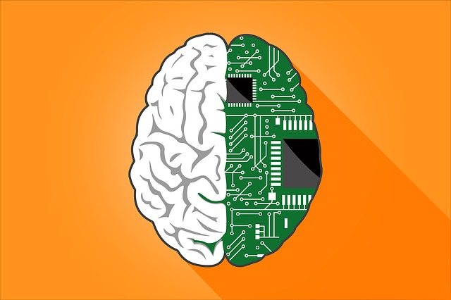

Table of contents
01
02
03
Problem
Function of AI in
E-learning
Conclusion and Notes

Slide 3


01
Round-Robin

Slide 4
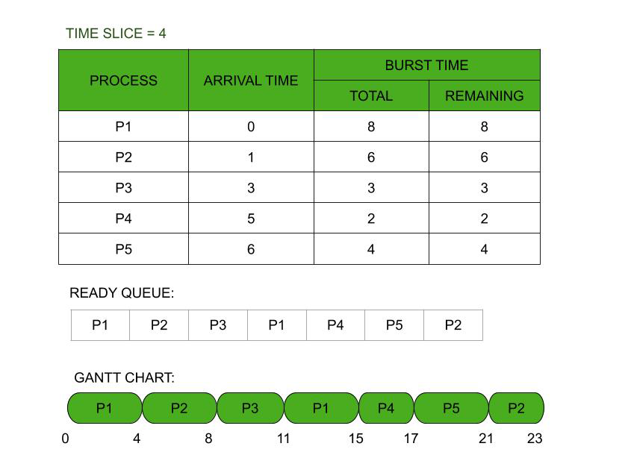
What is Round Robin algorithm ?
Round-robin algorithm in computing is a scheduling approach
is like taking turns in a line. Each task gets a fixed time to use resources.
This simple method helps prevent resource monopolization.

Slide 5
What is Time Quantum ?
A Time Quantum is the amount of time share give to each process, interrupting the job if it is not completed by then

Slide 6
What is Request Queue?
A request queue is the order by which processes arrive and are handled

Slide 7
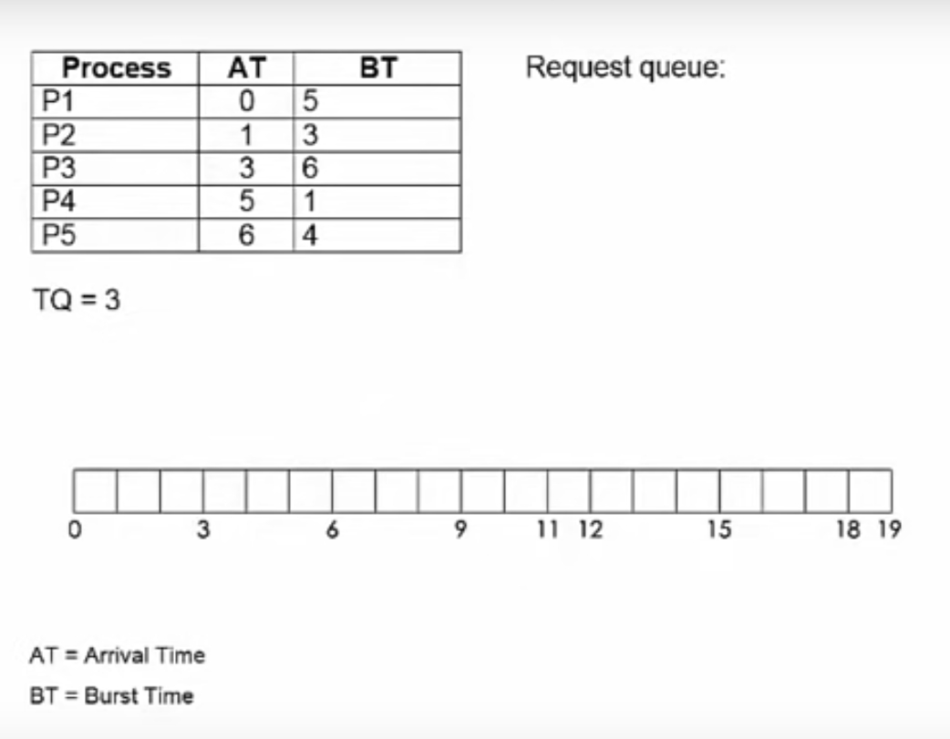

Slide 8
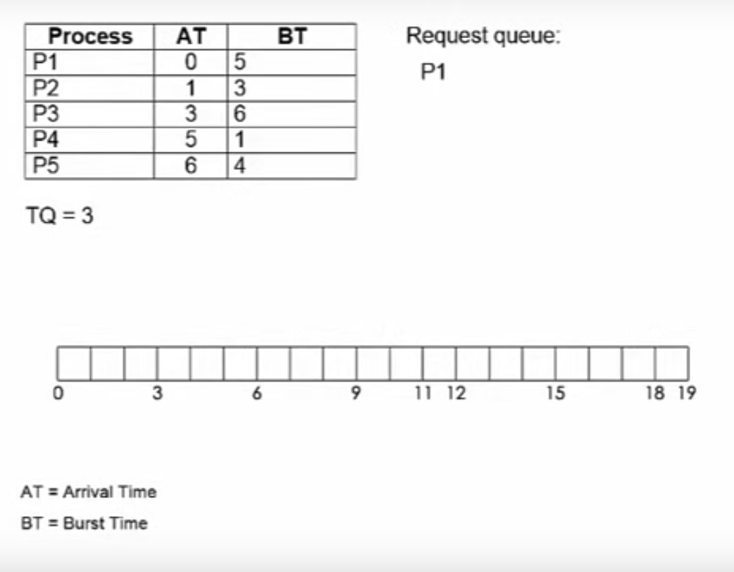

Slide 9
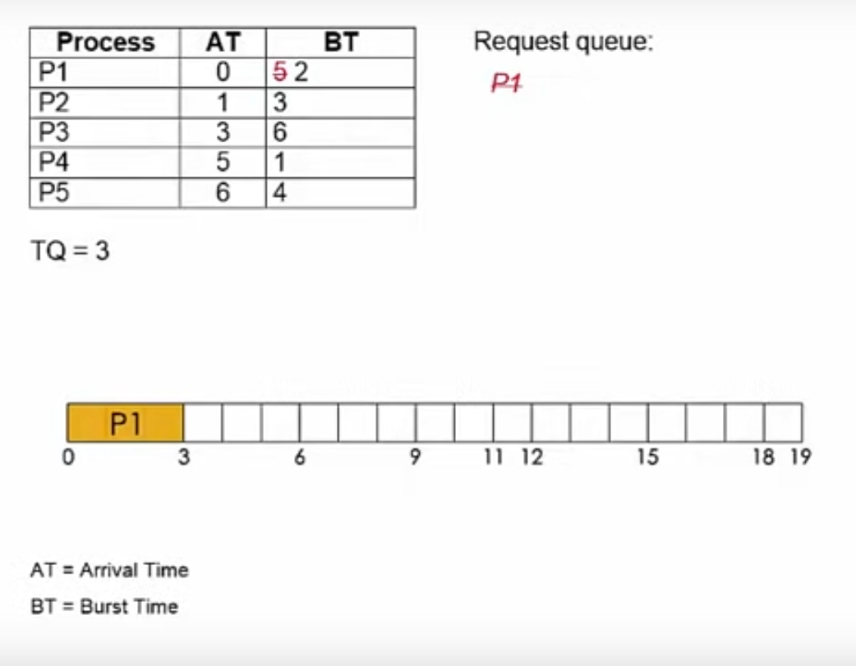

Slide 10
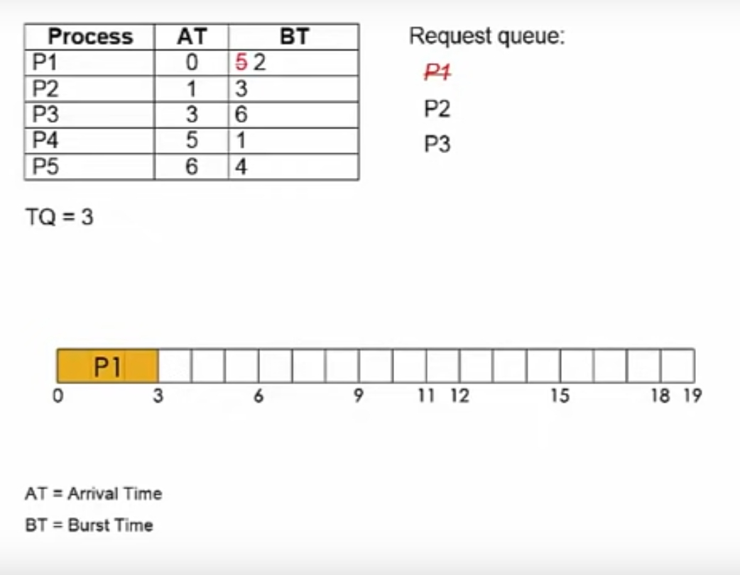

Slide 11
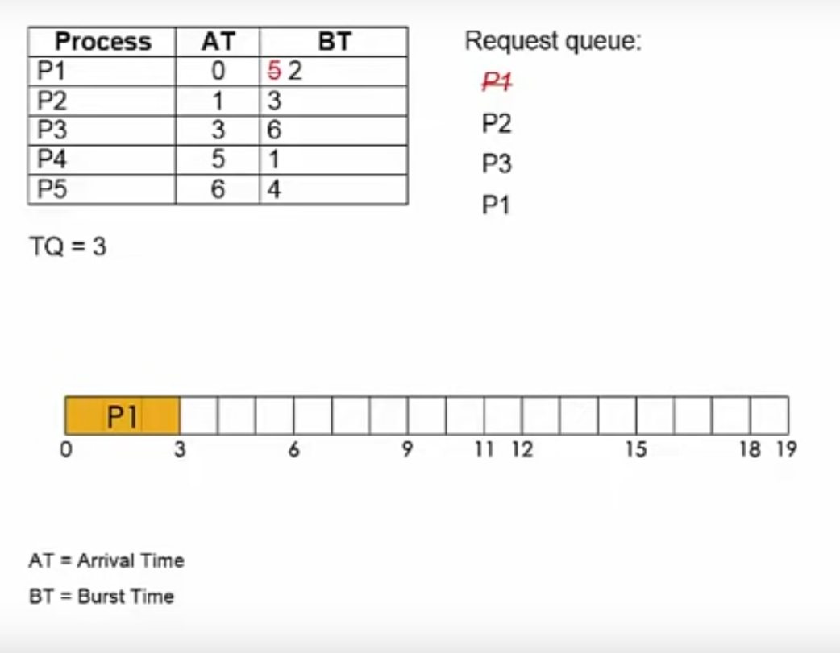

Slide 12
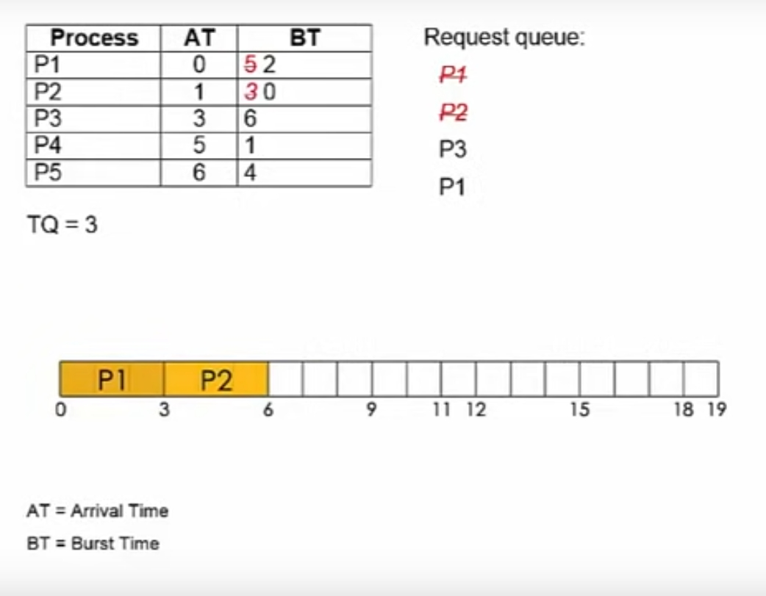

Slide 13
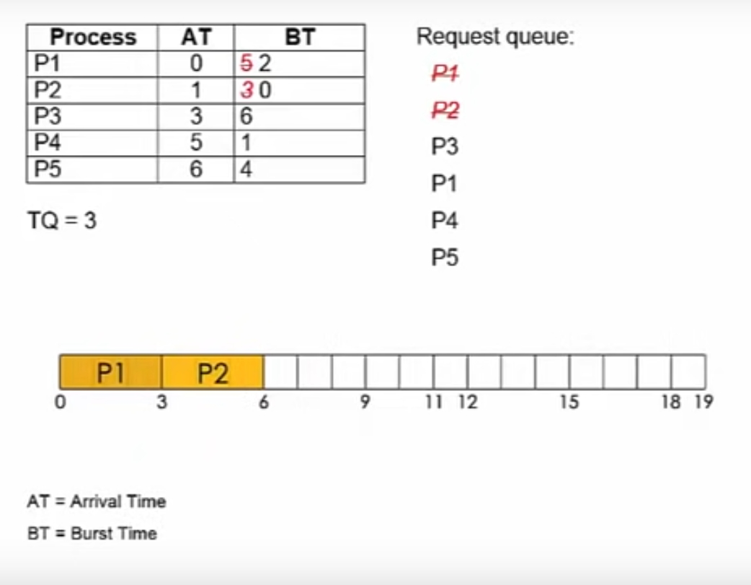

Slide 14
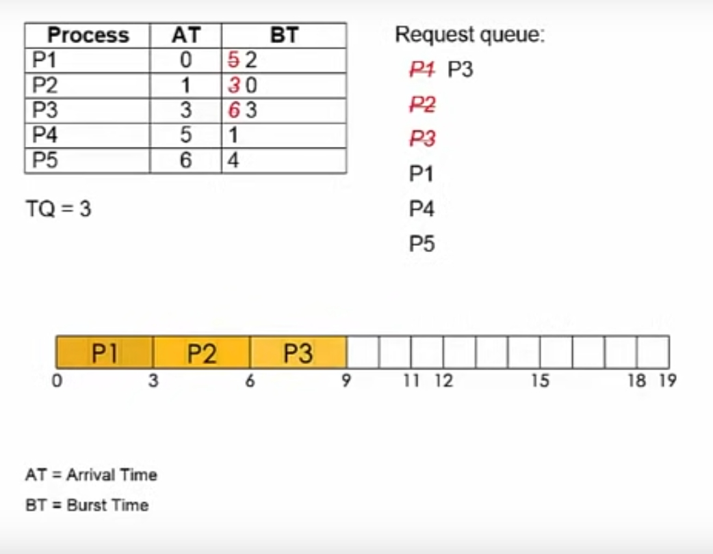

Slide 15
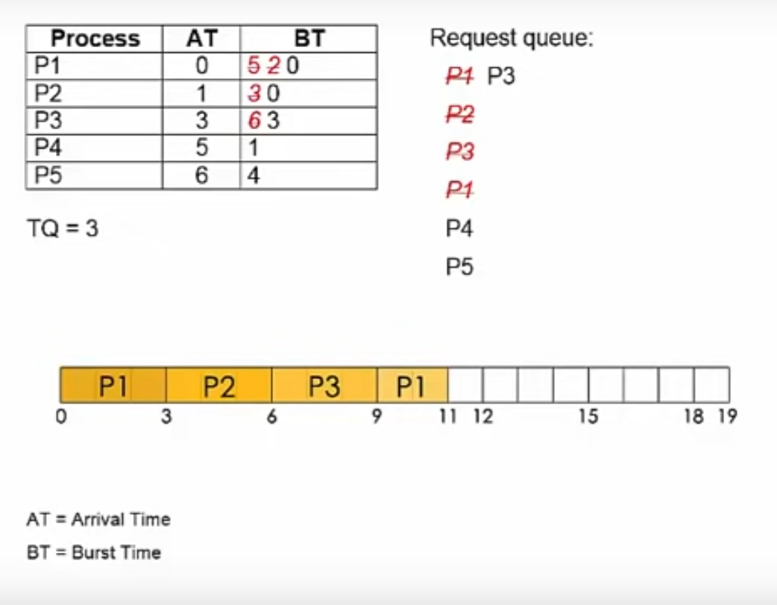

Slide 16
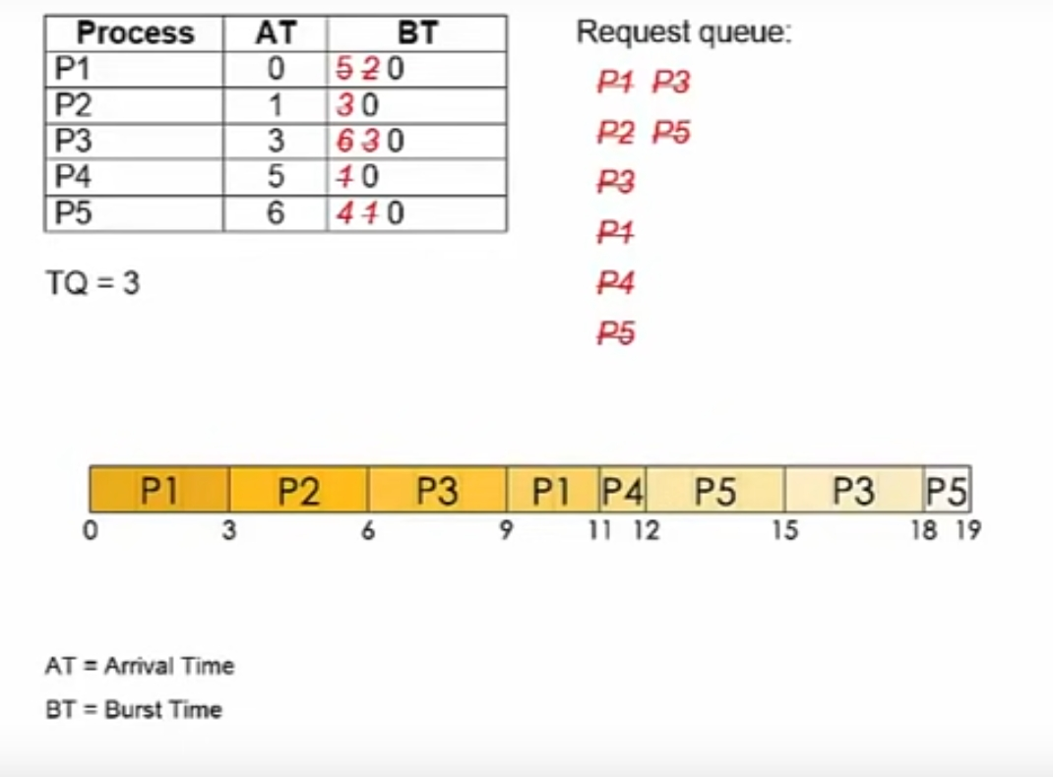

Slide 17


Personalize learning in the online environment
Students are diverse in knowledge, abilities and learning styles.

Slide 18

Personalize learning in the online environment
Students will use e-learning websites to communicate with teachers

Slide 19


However, in a system without AI support, it becomes hard to customize the learning content.
Teachers will have to process large amounts of information and data to meet the needs of every individual student.
This requires a lot of time, effort and resources, reducing the efficiency and uniformity of the learning process.

Slide 20

Response and instructions to the student.
In a traditional E-Learning system, ensuring instant feedback and individual instruction for every student is a major challenge.

Slide 21
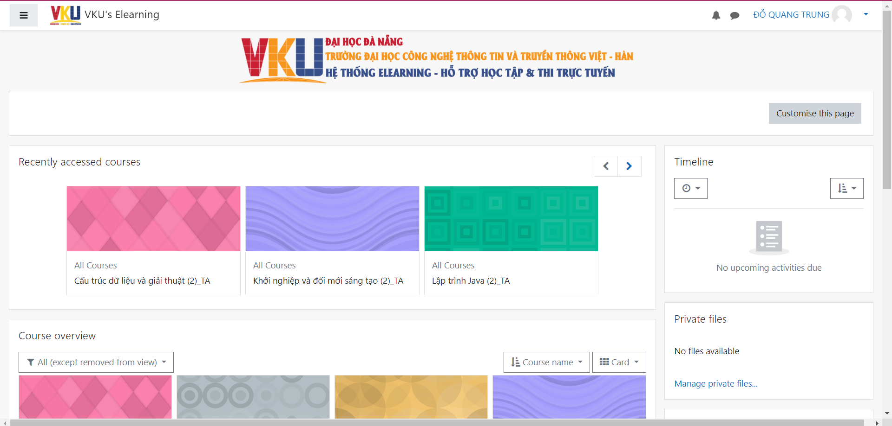

Response and instructions to the student.

Slide 22


Response and instructions to the student.
Teachers need to spend a lot of time and effort reading and evaluating assignments, and providing detailed feedback and individualized instruction to every student.
This can put a lot of pressure on instructors and limit their ability to respond and provide quality instruction.

Slide 23






Feedback and detailed guidance
Detect and correct errors
Suggest effective learning methods
Provide individual advice for learners to quickly improve their skills.

Slide 24
LEAST FREQUENTLY USED
02
Mai Dinh Gia Thinh

Slide 25

LFU: Least Frequently Used
IDEA
Replacing the page that has the smallest frequency

Slide 26
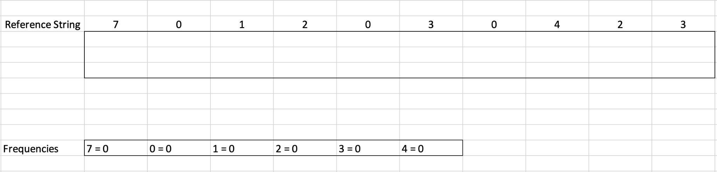
LFU: Least Frequently Used

Slide 27
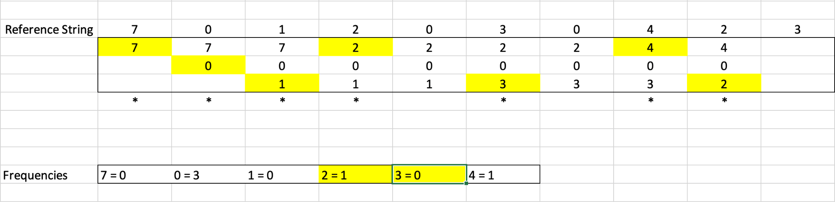
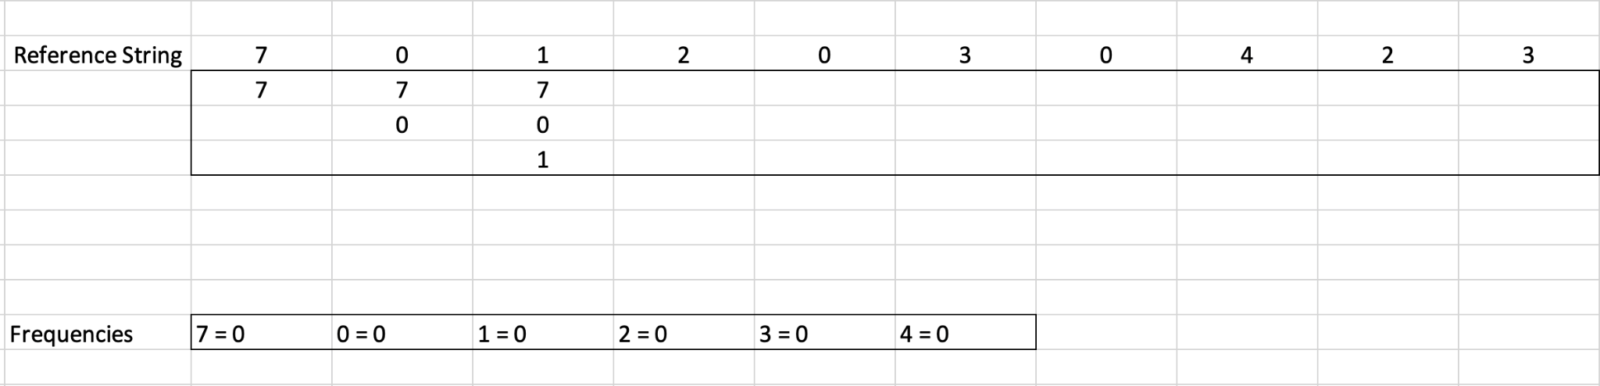
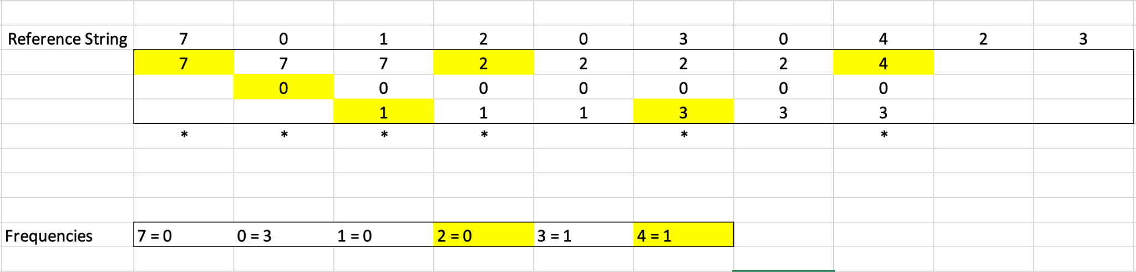
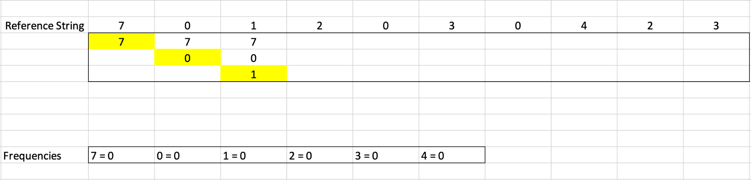
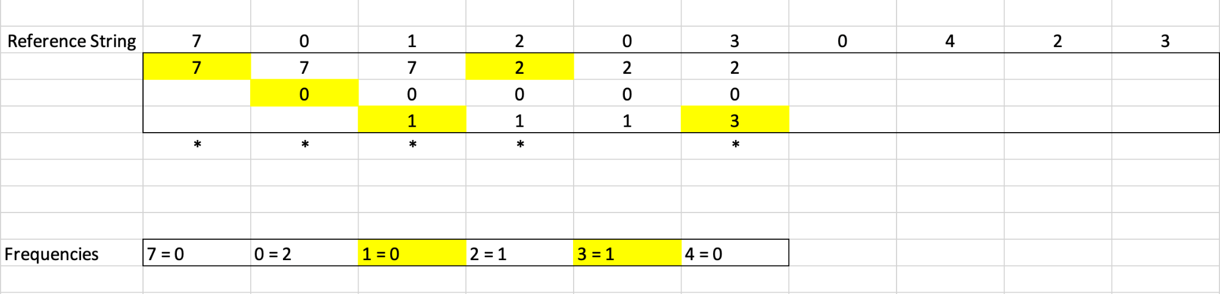
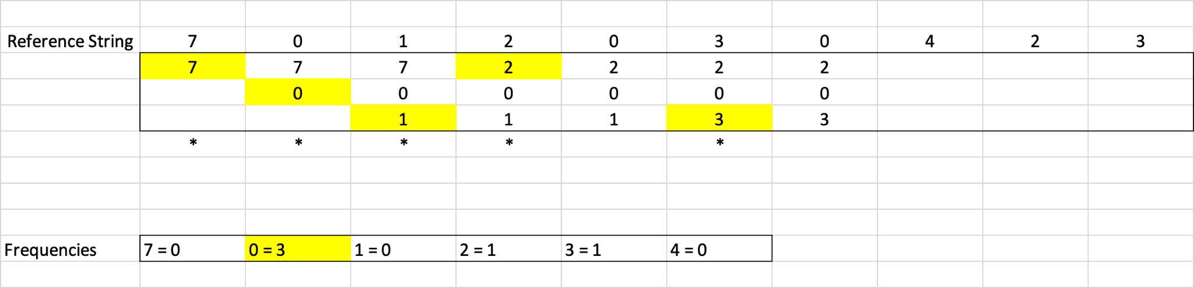
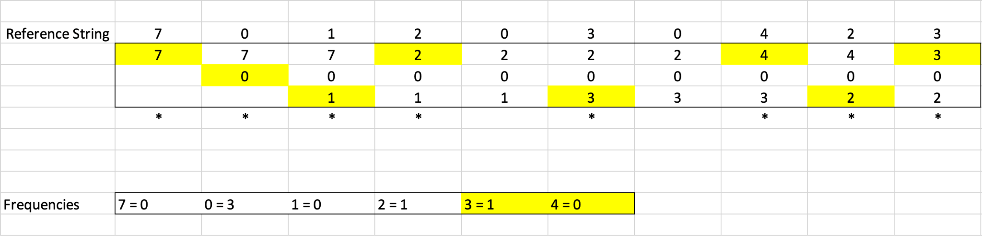
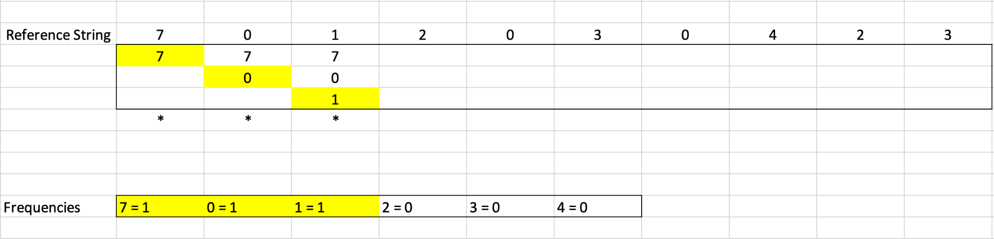
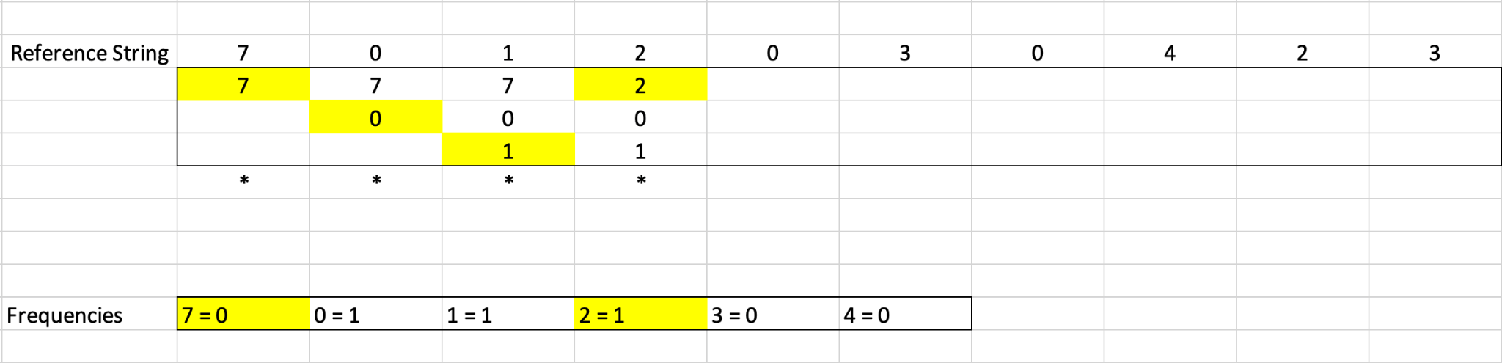
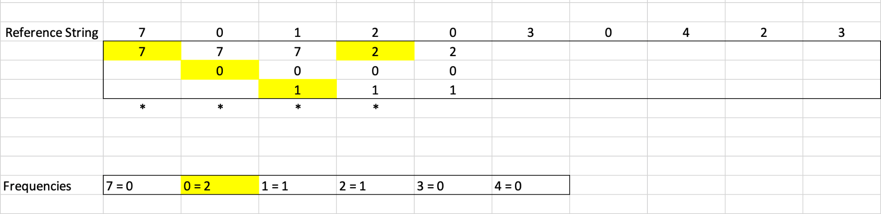
LFU: Least Frequently Used

Slide 28
LEAST RECENTLY USED
03
Nguyen Vo Van Man

Slide 29
LRU: Least Recently Used
Concept
is a cache replacement algorithm. It is designed to replace the least recently used data when the cache memory is full
LRU
.
.
..
a1
.
.
..
Idea
Most recently used data will be moved to the bottom of the list and pushes the least recently used data to the top and will be deleted if new data arrives.
an
an
MRU

Slide 30
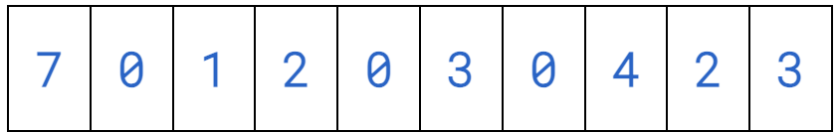






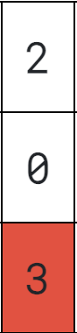




Example for LRU
LRU
0
1
2
MRU

Slide 31
Optimal Replacement Algorithm
04
Đỗ Quang Trung

Slide 32
ORA: Optimal replacement
Is a memory management algorithm whose main goal is to replace pages that are evicted from memory in such a way that the page will not be used for the longest time to come.
The basic idea of ​​ORA is to choose, based on information about future page usage, which pages to keep and which pages to replace.

Slide 33
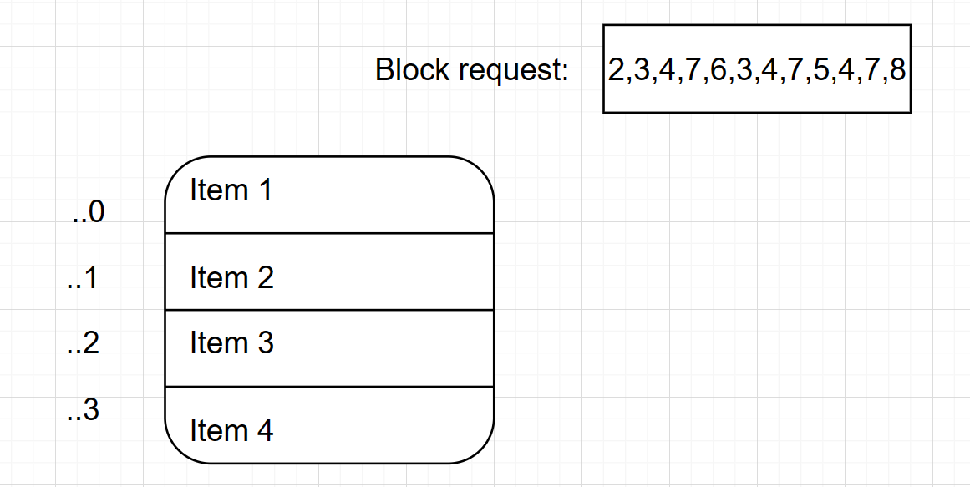
Example for ORA
Cache with four lines:

Slide 34
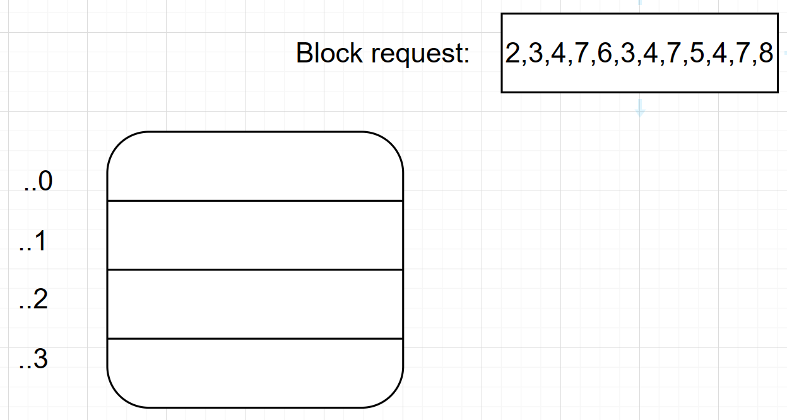
Example for ORA
Fill the cache lines by FIFO with the first four block request
2
3
4
7

Slide 35
Example for ORA
Replace block 2 with block 6
Block 2 is not used in future requests
Blocks 3, 4, 7 are already in the cache line
2
6
2
3
4
7

Slide 36
Example for ORA
Block 3,6 are not appear in the future request
Replace block 3 with block 5 based on FIFO
Block 4, 7 are already in the cache lines
6
3
5
4
7

Slide 37
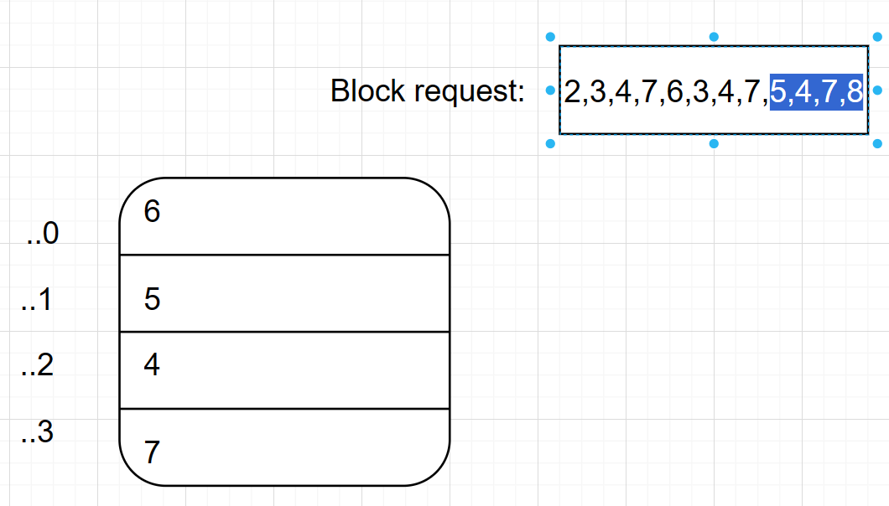
Example for ORA
The last block 8 will replace block 4 based on FIFO
8

Slide 38
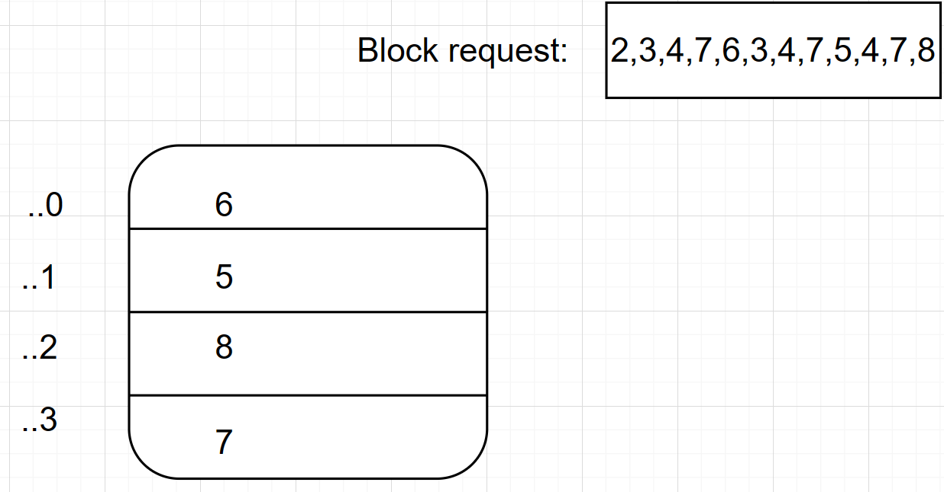
Example for ORA
Final results in main memory after using Optimal replacement

Slide 39
Benefits
Personalized learning
Creating learning content
Instant feedback

Slide 40
Thank you for your listening!

